Slide 1

The data class a.k.a. the Pandas class (but it’s not)
Pietro Berkes & Verjinia Metodieva

Slide 2
Data structures
This is an open question to the class
Which data structures do you know?
What makes you choose a data structure over another?
What do you consider, when thinking about data?
Notes:
Open questions and we collect the ideas on the whiteboard

Slide 3
Thinking about data in terms of
Processing
Storage
Reproducibility and collaboration

Slide 4
Thinking about data in terms of
This is an open question to the class
Processing
Storage
Reproducibility and collaboration
Efficient processing (no for-loops!)
Organizing data so that analyses are easy
Size
Access ease
Access time
Versioning
Lineage tracing (which script / other data was used to generate this?)
Ease of sharing
These are criteria for selecting a data structure

Slide 5
All the data structures
Delete ?
list: ordered, heterogeneous storage, stack/queue, fast access by index, slow search
set: unordered
dictionary
arrays: e.g. numpy, HDF5
tables: e.g. pandas, dask, spark, SQL
graph: social network structure
tree: to rapidly search a dataset
heap
stack
queue
priority queue

Slide 6
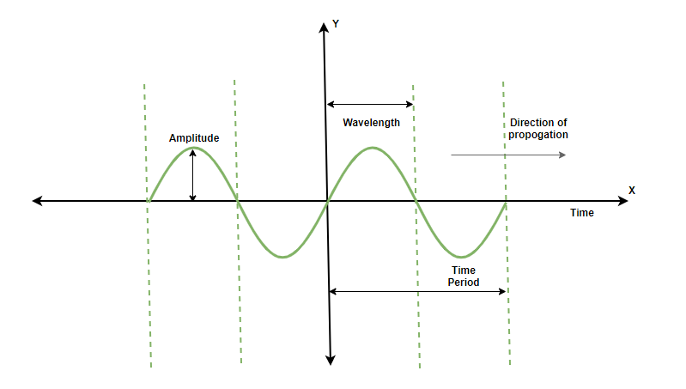
What data structure would you use to represent
a sound wave?

Slide 7
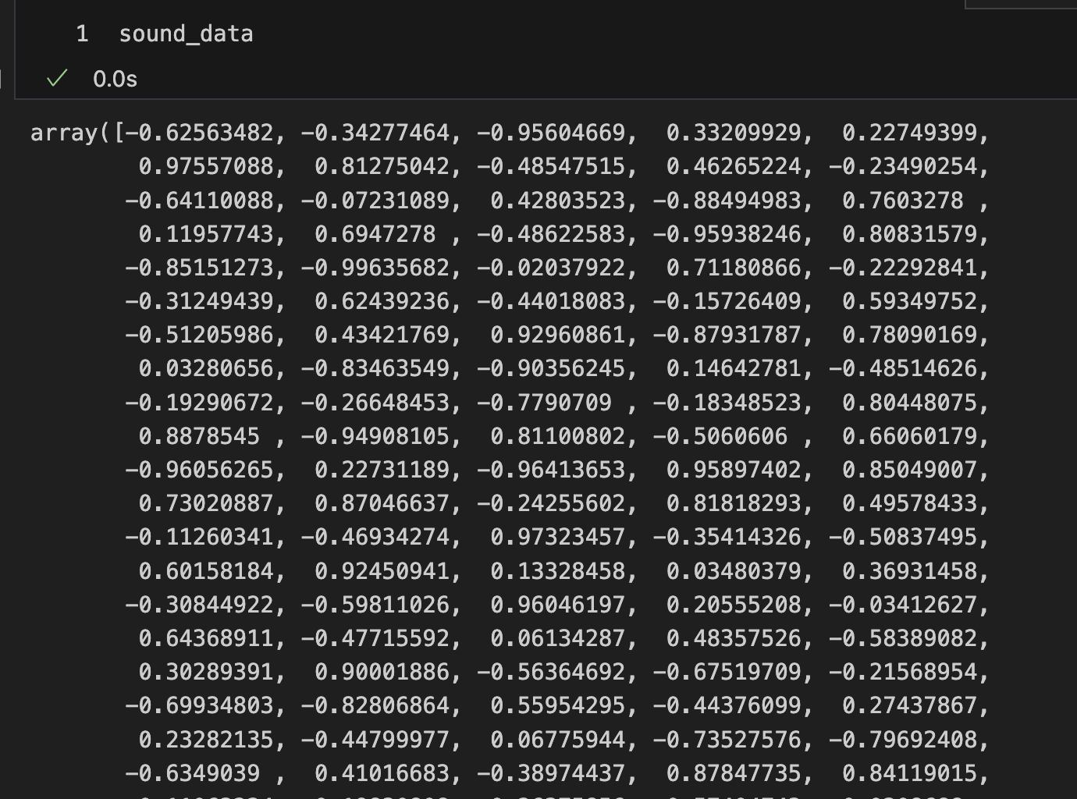
what data structure would you use to represent
a sound wave?
NumPy array

Slide 8
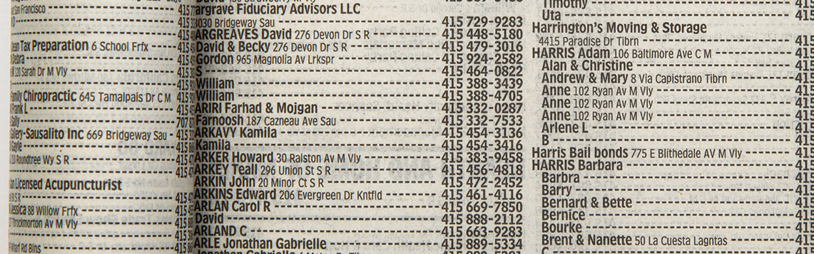
what data structure would you use to represent
phone book entries?
a sound wave?
NumPy array

Slide 9
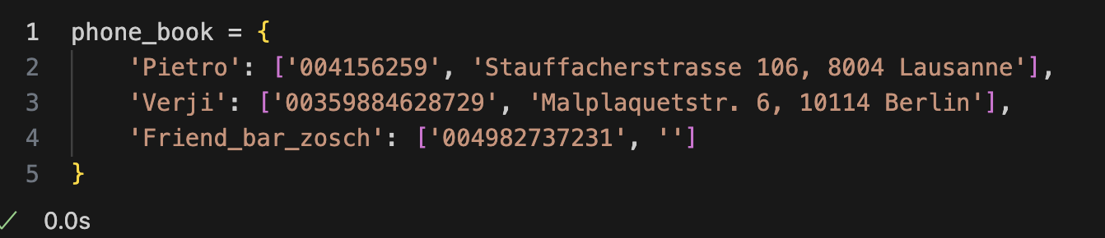
what data structure would you use to represent
phone book entries?
dictionary
a sound wave?
NumPy array

Slide 10
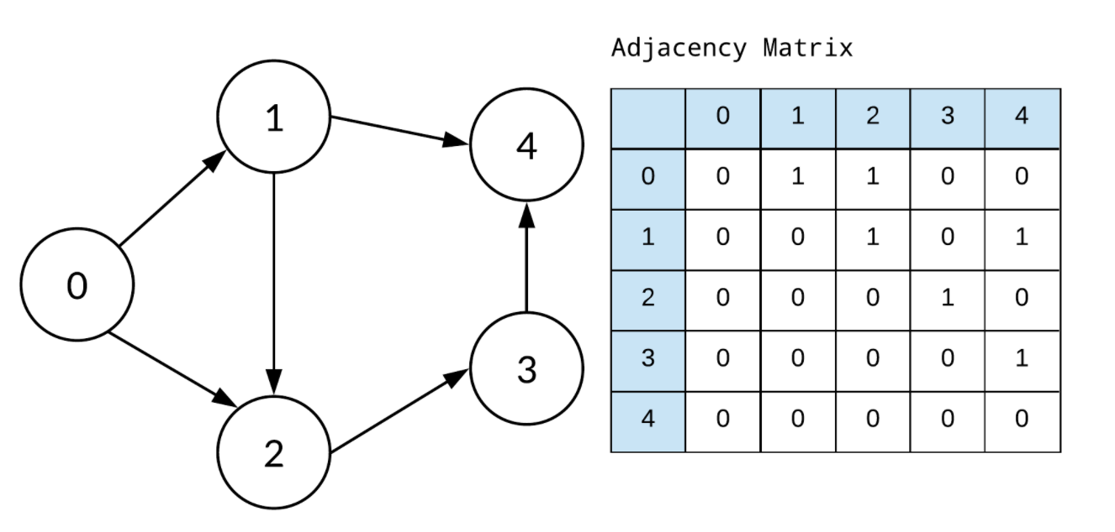
what data structure would you use to represent
phone book entries?
dictionary
a sound wave?
NumPy array
a graph?

Slide 11
what data structure would you use to represent
phone book entries?
dictionary
a sound wave?
NumPy array
a graph?
adjacency matrix

Slide 12
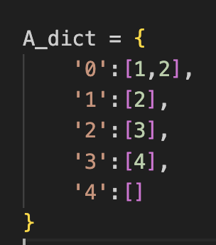
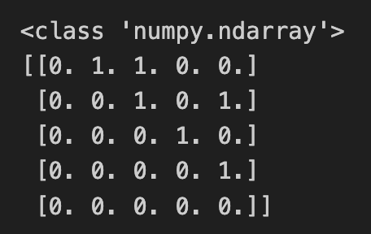
what data structure would you use to represent
phone book entries?
dictionary
a sound wave?
NumPy array
OR
adjacency matrix
NumPy array
a graph?
dictionary
Notes:
Family tree instead of a graph
Arrange better, too busy

Slide 13
Code developed on small data set, how is it going to scale to the complete data set?
What counts is how the computing time scales as the data becomes larger! That’s by far the dominating factor. We’re interested in order of magnitude.
Development data
Real data
N data points,
Processing time T
10x N data points
Processing time -> ?
Notes:
Data and code are related.
Nice transition from the last question. In extreme case, when the relations in the graph are dynamic/ changing a lot →using a dictionary is not a good solution. Instead, when small dataset and we are mainly interested in visualizing the relations, it might be.
The NumPy array solutions, scales much better, in case there are hundreds of dynamically changing relations to inspect.

Slide 14
Problem solving, implementing different data structures
Use notebook-1-sorting-examples.ipynb

Slide 15

Example: Find common words
VM: should we have these slides as an interactive Jupyter notebook?
DELETE
Problem: given two lists of words, extract all the words that are in common

Slide 16

Implementation with 2x for-loops
DELETE
What is the big-O complexity of this implementation?

Slide 17
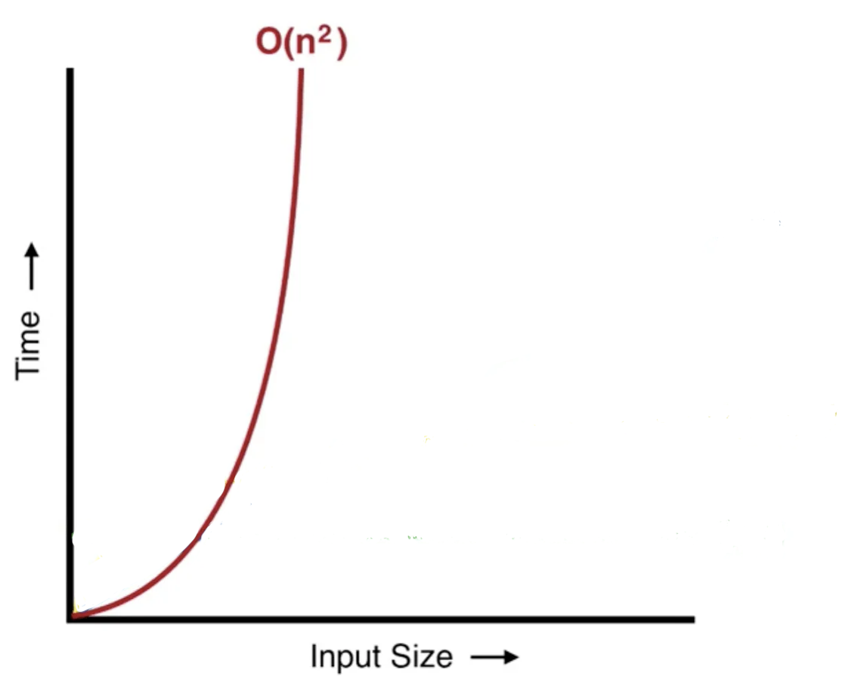
Implementation with 2x for-loops
DELETE
What is the big-O complexity of this implementation?
n * n ~ O(n²)
VM : FORMAT FORMULAS so that they are easier to read

Slide 18
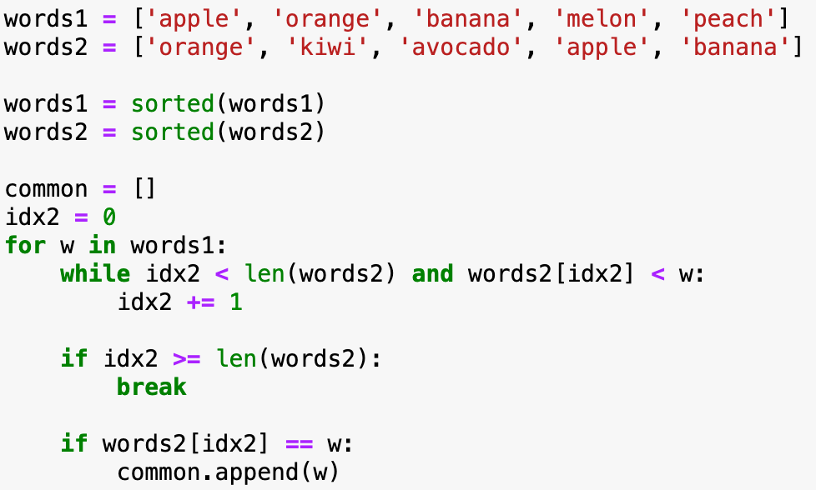

Implementation with sorted lists
DELETE
What is the big-O complexity of this implementation?

Slide 19
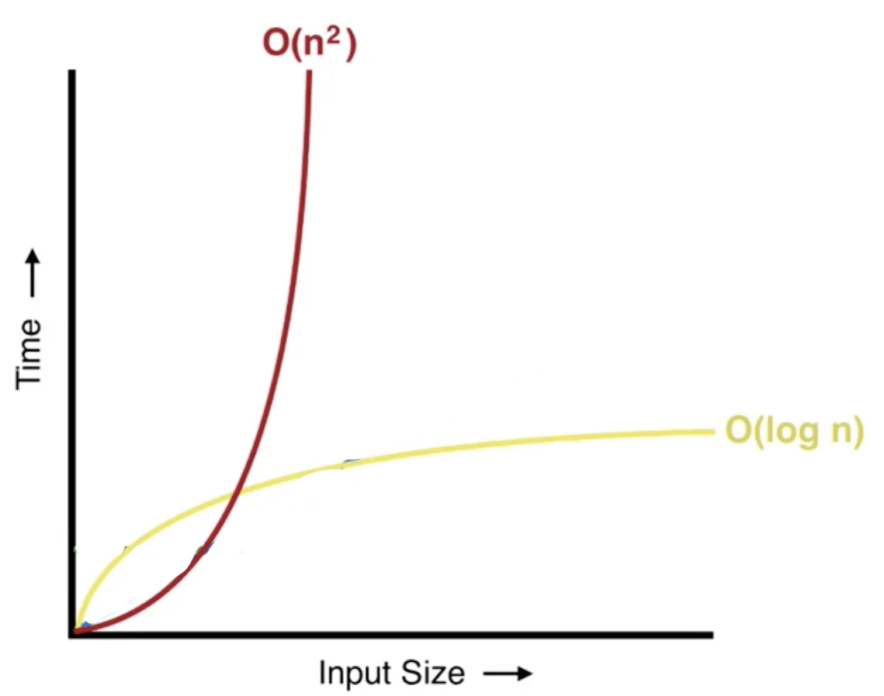
Implementation with sorted lists
DELETE
VM : FORMAT FORMULAS so that they are easier to read
What is the big-O complexity of this implementation?
2 * sorting + traversing two lists = 2*n log_{n} + 2*n ~ O(n * log_{n})

Slide 20
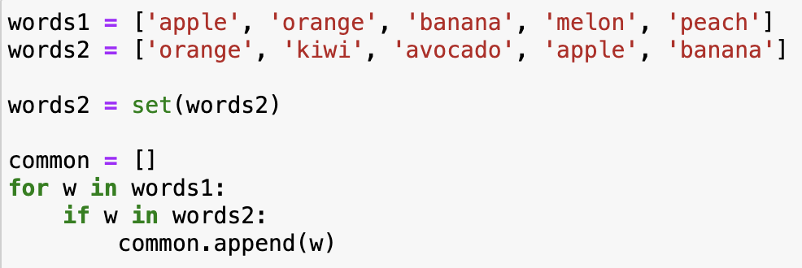
Implementation with sets
DELETE
What is the big-O complexity of this implementation?

Slide 21
Implementation with sets
DELETE
What is the big-O complexity of this implementation?
transforming one list to set + 1 for loop = 2 * n ~ O(n)
It’s the exact same code as for lists, but now looking up an element in sets (if w in words2) takes constant time!
How could you have known that set lookup is fast? Learning about data structures!
VM : FORMAT FORMULAS so that they are easier to read

Slide 22
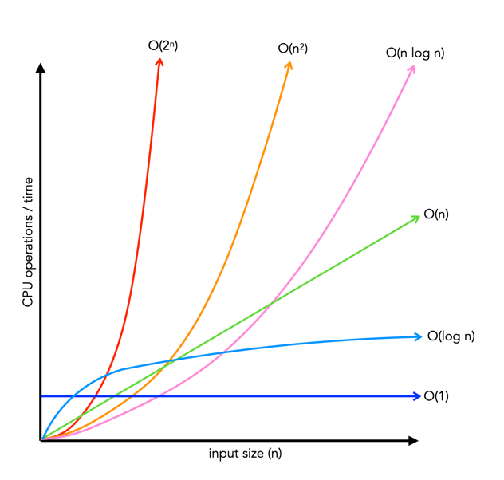
How performance scales: big-O
sorted
lists
2 for loops
sets
Notes:
Change the axes labels → bigger

Slide 23
How performance scales: big-O
Fill this column with them: can you think of any operation on lists that scales this way?
Big-O class | Name | Time increase, when data increases 10x
O(1) | constant | 1x time
O(n) | linear | 10x time
O(n²) | quadratic | 100x time
O(n * log n) | linearithmic | ~10-20x time
O(log n) | logarithmic | ~1-2x time
sorted
lists
2 for loops
sets

Slide 24
How performance scales: big-O
Fill this column with them: can you think of any operation on lists that scales this way?
Big-O class | Name | Time increase, when data increases 10x
O(1) | constant | 1x time
O(n) | linear | 10x time
O(n²) | quadratic | 100x time
O(n * log n) | linearithmic | ~10-20x time
O(log n) | logarithmic | ~1-2x time
sorted
lists
2 for loops
sets
Big-O class | Operation on lists that scales this way
O(1)
O(n)
O(n²)
O(n * log n)
O(log n)

Slide 25
How performance scales: big-O
Big-O class | Name | Time increase, when data increases 10x | Operation on lists that scales this way
O(1) | constant | 1x time | Getting first element
O(n) | linear | 10x time | Summing data in list
O(n²) | quadratic | 100x time | Computing the distance between all pairs of elements in the list (double for-loop through list)
O(n * log n) | linearithmic | ~10-20x time | Sorting the list
O(log n) | logarithmic | ~1-2x time | Searching an element in a sorted list

Slide 26

How performance scales: big-O
Big-O class | Name | Time increase, when data increases 10x | Operation on lists that scales this way
O(1) | constant | 1x time | Getting first element
O(n) | linear | 10x time | Summing data in list
O(n²) | quadratic | 100x time | Computing the distance between all pairs of elements in the list (double for-loop through list)
O(n * log n) | linearithmic | ~10-20x time | Sorting the list
O(log n) | logarithmic | ~1-2x time | Searching an element in a sorted list
Question: how does parallelization, or re-writing the code in a faster programming language, influence the performance?
E.g. parallelize O(n^2) problem
In general we need to distinguish between “fast” in absolute terms for a fixed problem size, and “fast” in the sense of how well it scales

Slide 27
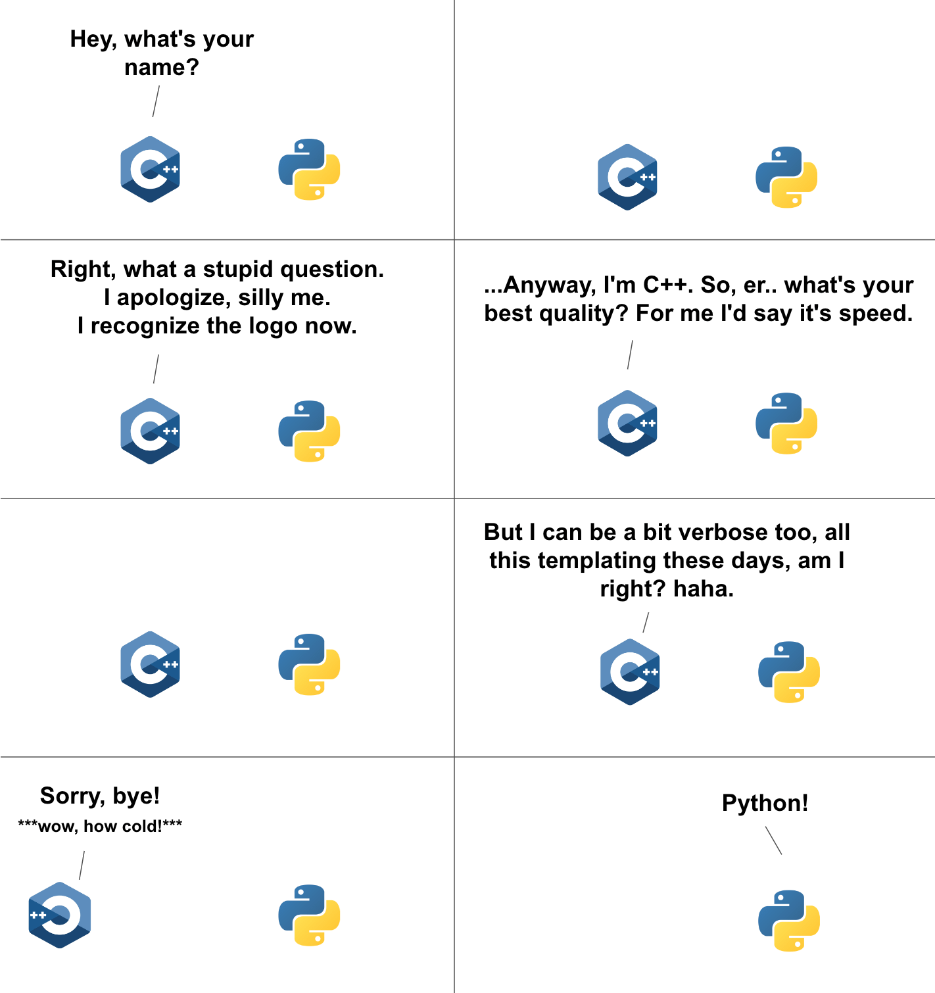


VM: please work on this slide
Fast code
O(n^2)
Regular code
O(n)
Fast code
(parallel, Cython)
O(n^2)
Notes:
Parallelization lowers the curves.
For a fixed code, linear code is no necessarily faster.
Important when n is growing
Parallelization/ optimization → you can make the code faster for any fixed N, but the shape (of growth) can never change

Slide 28
Basic information about Python data structures
lists: collection of ordered, arbitrary data
getting an element by index: O(1)
appending: O(1)
inserting an element: O(n)
sorting: O(n * log n)
finding an element (e.g., ”if element in my_list: …”): O(n)
dictionaries (”hashmaps”)
inserting: O(1)
finding element by key: O(1)
sets (it’s just dictionaries without values)
inserting: O(1)
finding an element (e.g., ”if element in my_set: …”): O(1)
Notes:
Note that there may be different implementations of these data structures with different complexities, these are for the Python implementation.
E.g., if finding an element in a list is important, one could implement it as two dictionaries, one mapping indices to data, one mapping data to indices. Finding out the complexities of all the operations with this implementation is left as a homework.

Slide 29
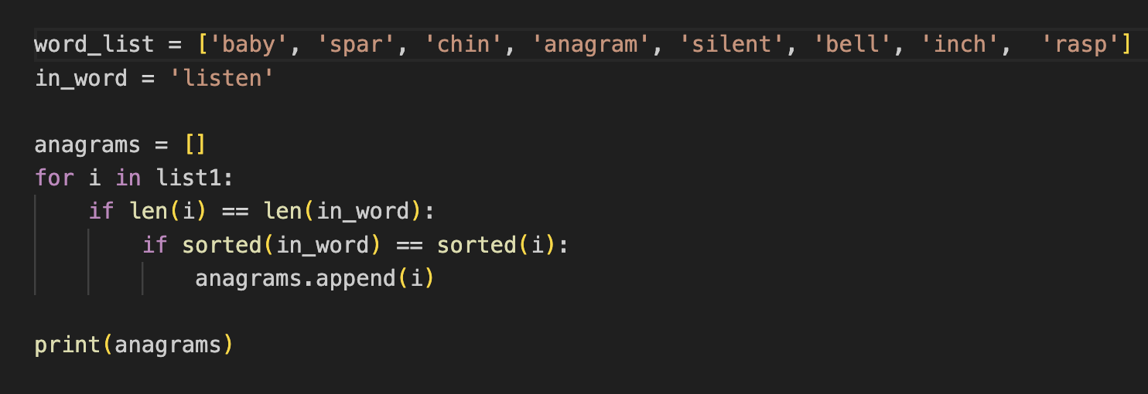
Exercise
You are given a long list of English words (len n)
The goal is to find all the anagrams of an input words (len m)
What data structure to use for the list of words?
Write the algorithm
What is the Big-O class of your algorithm?
VM: solution took 5 mins; not too difficult given that you’ve introduced the sorting algorithms
Fix slide with correct assignment and add the notebook for it
Notes:
Pre_processing : Dictionary: key (sorted letters) values (list of anagrams)
Give the exercise, 5 mins time (until half ready)
Tell them solution is Big O class (n+m) and can be achieved with pre-processing
Check at student laptops the dictionary
IN a notebook
cat /usr/share/dict/words
cat /usr/dict/words

Slide 30
NUMPY

Slide 31
NumPy – huh, yeah – what’s it good for?
Introduces new data structure: the array
An array could be represented as a list-of-lists
Why are NumPy arrays better than a list-of-lists?
**Tiziano’s class**
An array is a regular, N-dimensional grid of data of the same type, typically numerical data

Slide 32
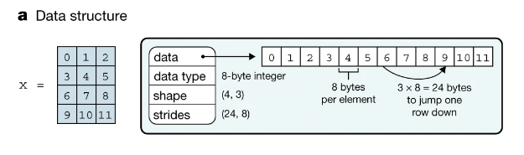
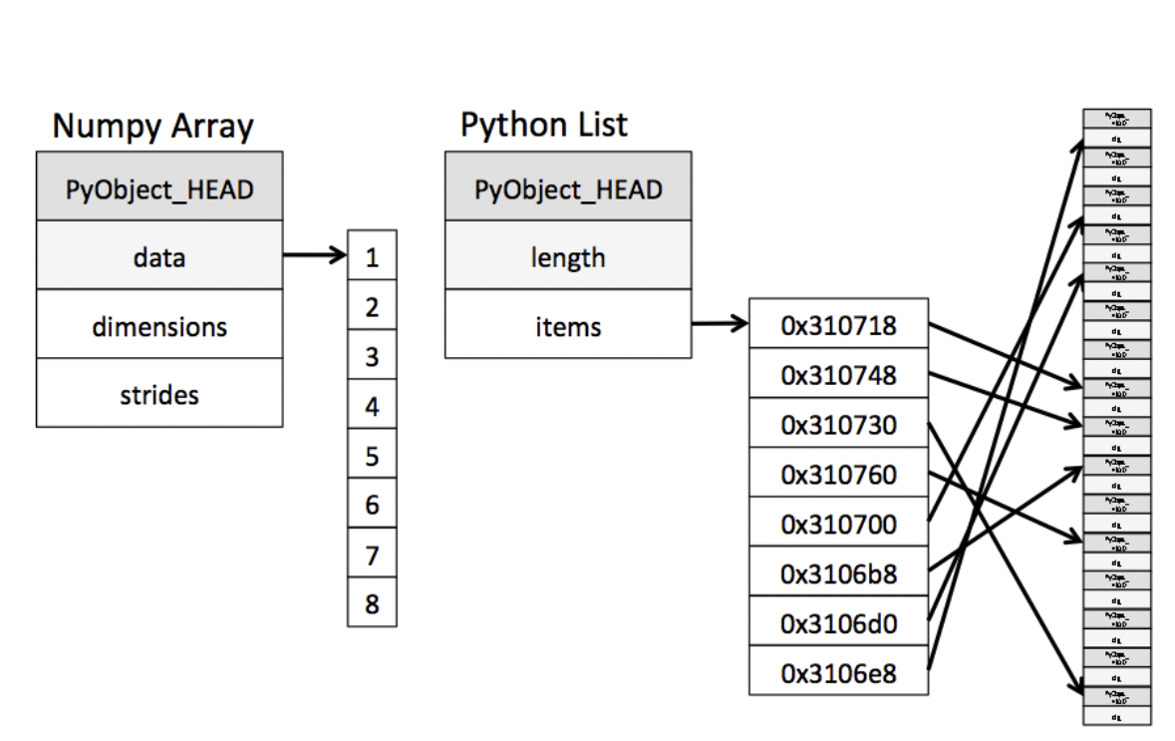
Efficiency of NumPy
Memory:
data occupies the minimum amount of memory required
some operations can be done without touching the memory at all!
Notes:
The standard Python implementation is written in C. This means that every Python object is simply a cleverly-disguised C structure, which contains not only its value, but metadata as well
a C integer is essentially a label for a position in memory whose bytes encode an integer value. A Python integer is a pointer to a position in memory containing all the Python object information, including the bytes that contain the integer value
NumPy handles looping over array elements near-optimally—for example, taking strides into consideration to best utilize the computer’s fast cache memory
Numpy array - single pointer to one contiguous block of data
The Python list, on the other hand, contains a pointer to a block of pointers, each of which in turn points to a full Python object

Slide 33
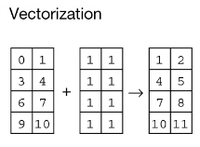
Efficiency of NumPy
Memory:
data occupies the minimum amount of memory required
some operations can be done without touching the memory at all!
Speed:
Many operations can be done very efficiently in C. For this to be useful, we need to avoid Python for-loops at all costs!
operating on entire arrays rather than their individual elements
→ “vectorize” the code
Notes:
Speed
Not only efficient storage of data but also
Numpy package comes with a efficient operations on the data done efficiently in C
Option (usually forced, when using NumPy) to operate on entire arrays rather than on their individual elements

Slide 34
NumPy’s memory efficiency

Slide 35
Memory block
The array data is stored in a contiguous memory block, using native data types
0 | 1 | 2 | 3 | 4 | 5 | 6 | 7 | 8
int64

Slide 36
Memory block
Metadata tells NumPy how to interpret the memory block
0 | 1 | 2 | 3 | 4 | 5 | 6 | 7 | 8
int64
8 bytes
24 bytes
NumPy array metadata
dtype | int64
ndim | 2
shape | (3, 3)
strides | (24, 8)

Slide 37
Memory block
Metadata tells NumPy how to interpret the memory block
0 | 1 | 2 | 3 | 4 | 5 | 6 | 7 | 8
int64
8 bytes
24 bytes
NumPy array metadata
NumPy view
dtype | int64
ndim | 2
shape | (3, 3)
strides | (24, 8)
0 | 1 | 2
3 | 4 | 5
6 | 7 | 8

Slide 38
Memory block
The same memory block can be interpreted in many ways
0 | 1 | 2 | 3 | 4 | 5 | 6 | 7 | 8
NumPy operation
NumPy view
0 | 1 | 2
3 | 4 | 5
6 | 7 | 8
What is changing?
x
x.ravel()
0 | 1 | 2 | 3 | 4 | 5 | 6 | 7 | 8
0 | 3 | 6
1 | 4 | 7
2 | 5 | 8
x.T
x[::2, ::2]
0 | 2
6 | 8
Notes:
As learned in Tiziano’s lecture, the memory block stays the same. What changes?
Metadata → how to interpret the block of memory

Slide 39
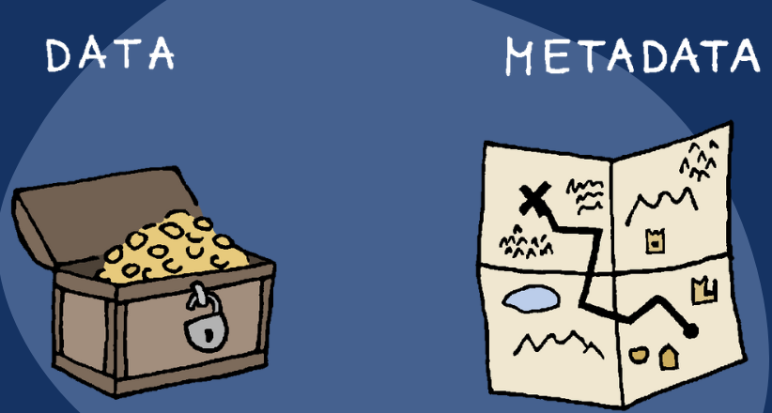
Memory block
The same memory block can be interpreted in many ways
0 | 1 | 2 | 3 | 4 | 5 | 6 | 7 | 8
NumPy operation
NumPy view
0 | 1 | 2
3 | 4 | 5
6 | 7 | 8
What is changing?
x
Only the metadata
x.ravel()
0 | 1 | 2 | 3 | 4 | 5 | 6 | 7 | 8
0 | 3 | 6
1 | 4 | 7
2 | 5 | 8
x.T
x[::2, ::2]
0 | 2
6 | 8
Notes:
As learned in Tiziano’s lecture, the memory block stays the same. What changes?

Slide 40
Memory block
Which is why some NumPy operations are super efficient, O(1)
0 | 1 | 2 | 3 | 4 | 5 | 6 | 7 | 8
NumPy operation
NumPy view
NumPy array metadata
0 | 1 | 2
3 | 4 | 5
6 | 7 | 8
dtype | int64
ndim | 2
shape | (3, 3)
strides | (24, 8)
x
dtype | int64
ndim | 1
shape | (9,)
strides | (8,)
x.ravel()
0 | 1 | 2 | 3 | 4 | 5 | 6 | 7 | 8
0 | 3 | 6
1 | 4 | 7
2 | 5 | 8
dtype | int64
ndim | 2
shape | (3, 3)
strides | (8, 24)
x.T
x[::2, ::2]
dtype | int64
ndim | 2
shape | (2, 2)
strides | (48, 16)
0 | 2
6 | 8
Notes:
The same memory block can be interpreted in many ways → that means that there are operations that cost nothing because they only change the metadata
Numpy view and operations
Operations that can only change the metadata → return a view (introduce new concept)

Slide 41
Operations that only change the metadata return a view, otherwise a new memory block needs to be allocated and they return a copy
Live: notebooks/numpy_views_and_copys
Rule of thumb, whenever possible NumPy tries to work with views instead of copies

Slide 42
Hands-on: view or copy? If view, how is the metadata changed?
Notebook: view_or_copy
Operation | View?
x[::2, :]
x[1, :]
x[1]
x[[1, 2, 0], [1, 1, 2]]
x[[0, 2], :]
x.reshape((6, 2))
x.ravel()
x.T.ravel()
x[(x % 2) == 1]
y = x + 2
y = np.sort(x, axis=1)
x
0 | 1 | 2 | 3
4 | 5 | 6 | 7
8 | 9 | 10 | 11
Notes:
Notebook – delete solutions

Slide 43
Numpy – Ufuncs
Unitary
Binary
Broadcasting
- https://jakevdp.github.io/PythonDataScienceHandbook/02.05-computation-on-arrays-broadcasting.html

Slide 44
A special kind of view: broadcasting operations
Memory block
0 | 1 | 2 | 3 | 4 | 5 | 6 | 7 | 8
NumPy array metadata
dtype | int64
ndim | 2
shape | (4, 9)
strides | (0, 8)
The shape says we have 4 rows and 9 columns
A stride of 0 means that for each new row, we don’t move in memory
Notes:
Special case, when one of the strides is 0 → duplicates without occupying more memory
Transition, other operations that can

Slide 45
A special kind of view: broadcasting operations
Memory block
As a result, we obtain a view with duplicated rows, without using extra memory!
0 | 1 | 2 | 3 | 4 | 5 | 6 | 7 | 8
NumPy array metadata
NumPy view
dtype | int64
ndim | 2
shape | (4, 9)
strides | (0, 8)
The shape says we have 4 rows and 9 columns
0 | 1 | 2 | 3 | 4 | 5 | 6 | 7 | 8
0 | 1 | 2 | 3 | 4 | 5 | 6 | 7 | 8
0 | 1 | 2 | 3 | 4 | 5 | 6 | 7 | 8
0 | 1 | 2 | 3 | 4 | 5 | 6 | 7 | 8
A stride of 0 means that for each new row, we don’t move in memory
Notes:
Stride == 0 → then we are not actually moving in memory, same memory, we are looping over the same thing

Slide 46
Rules of Broadcasting
Broadcasting in NumPy follows a strict set of rules to determine the interaction between the two arrays:
Rule 1: If the two arrays differ in their number of dimensions, the shape of the one with fewer dimensions is padded with ones on its leading (left) side.
Rule 2: If the shape of the two arrays does not match in any dimension, the array with shape equal to 1 in that dimension is stretched to match the other shape.
Rule 3: If in any dimension the sizes disagree and neither is equal to 1, an error is raised.
To make these rules clear, let's consider a few examples in detail.
Notes:
Show 1,2 examples and the notebook with the rules/ their implementation

Slide 47
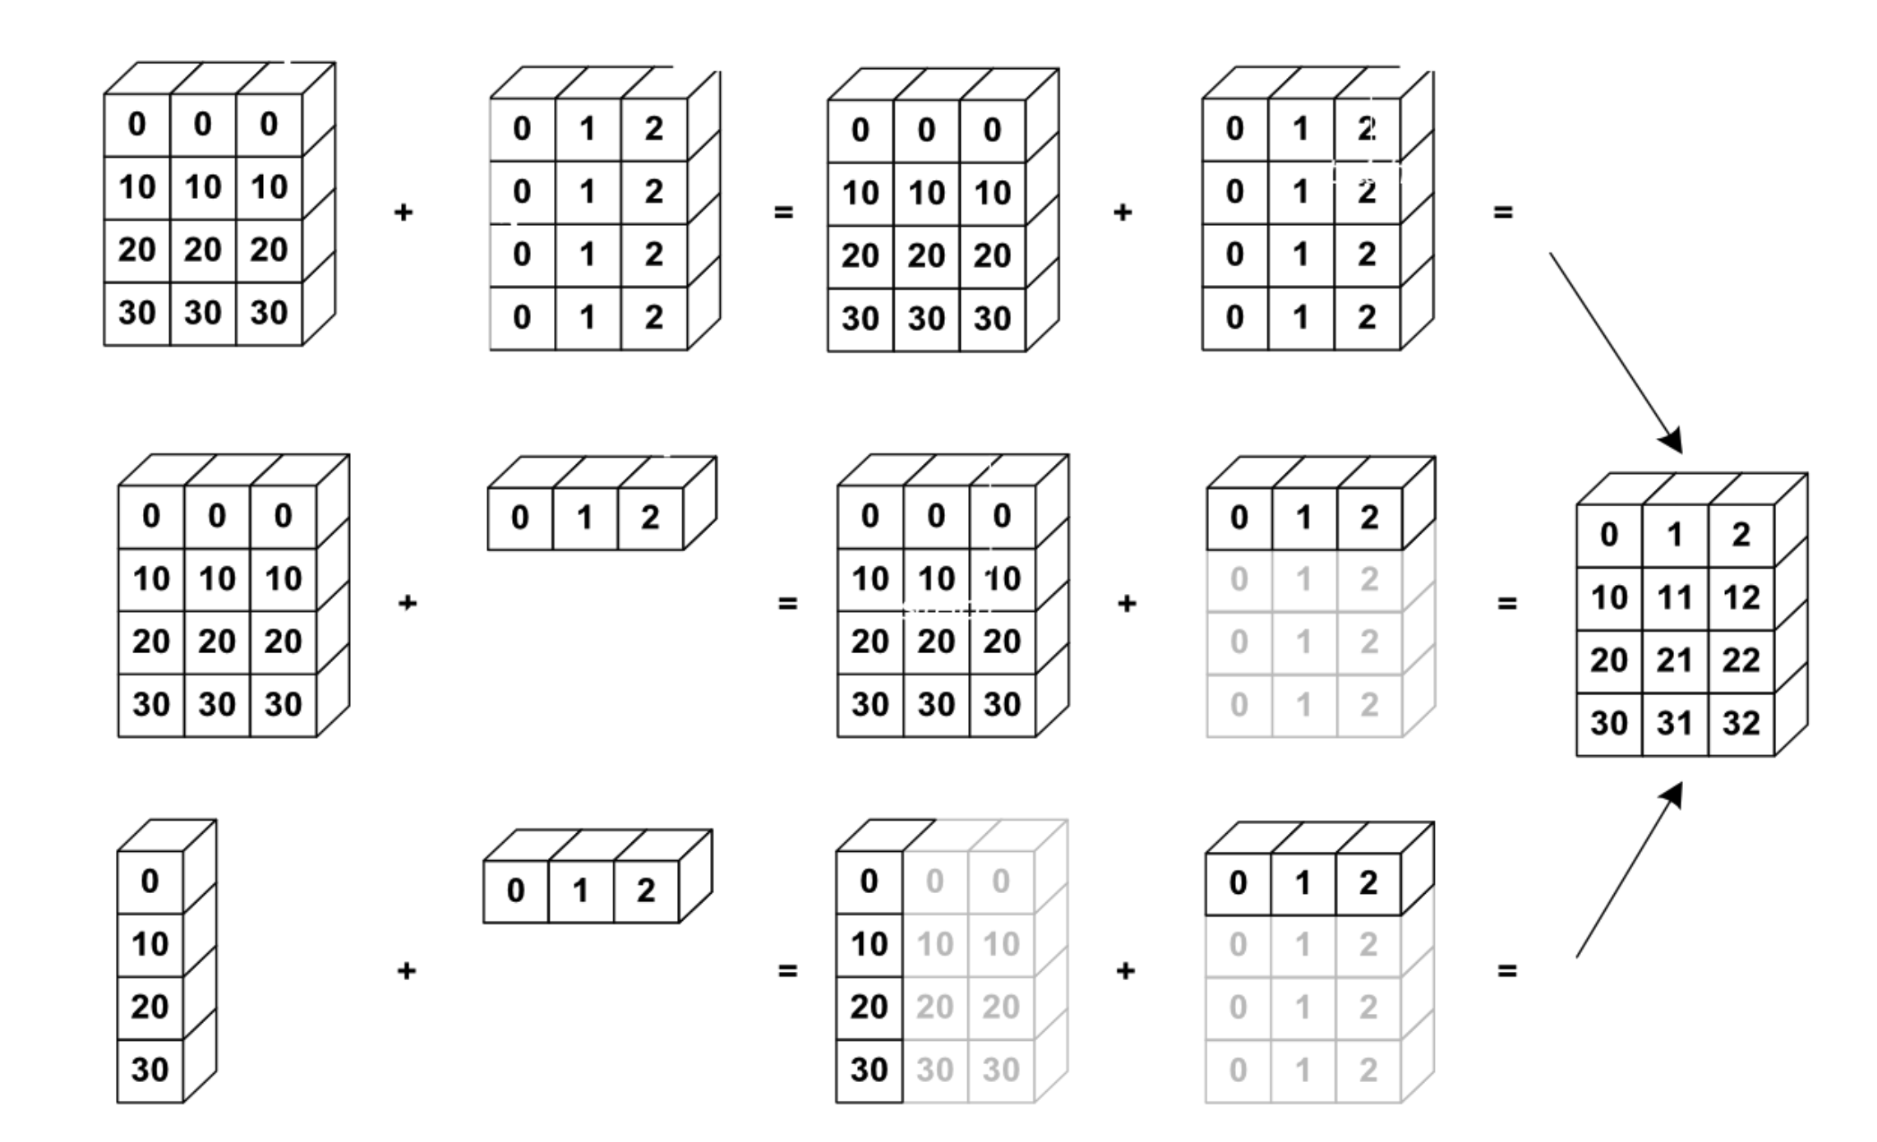
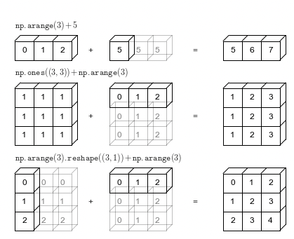
NumPy uses broadcasting to perform operation on arrays of different shape without having to allocate extra memory

Slide 48
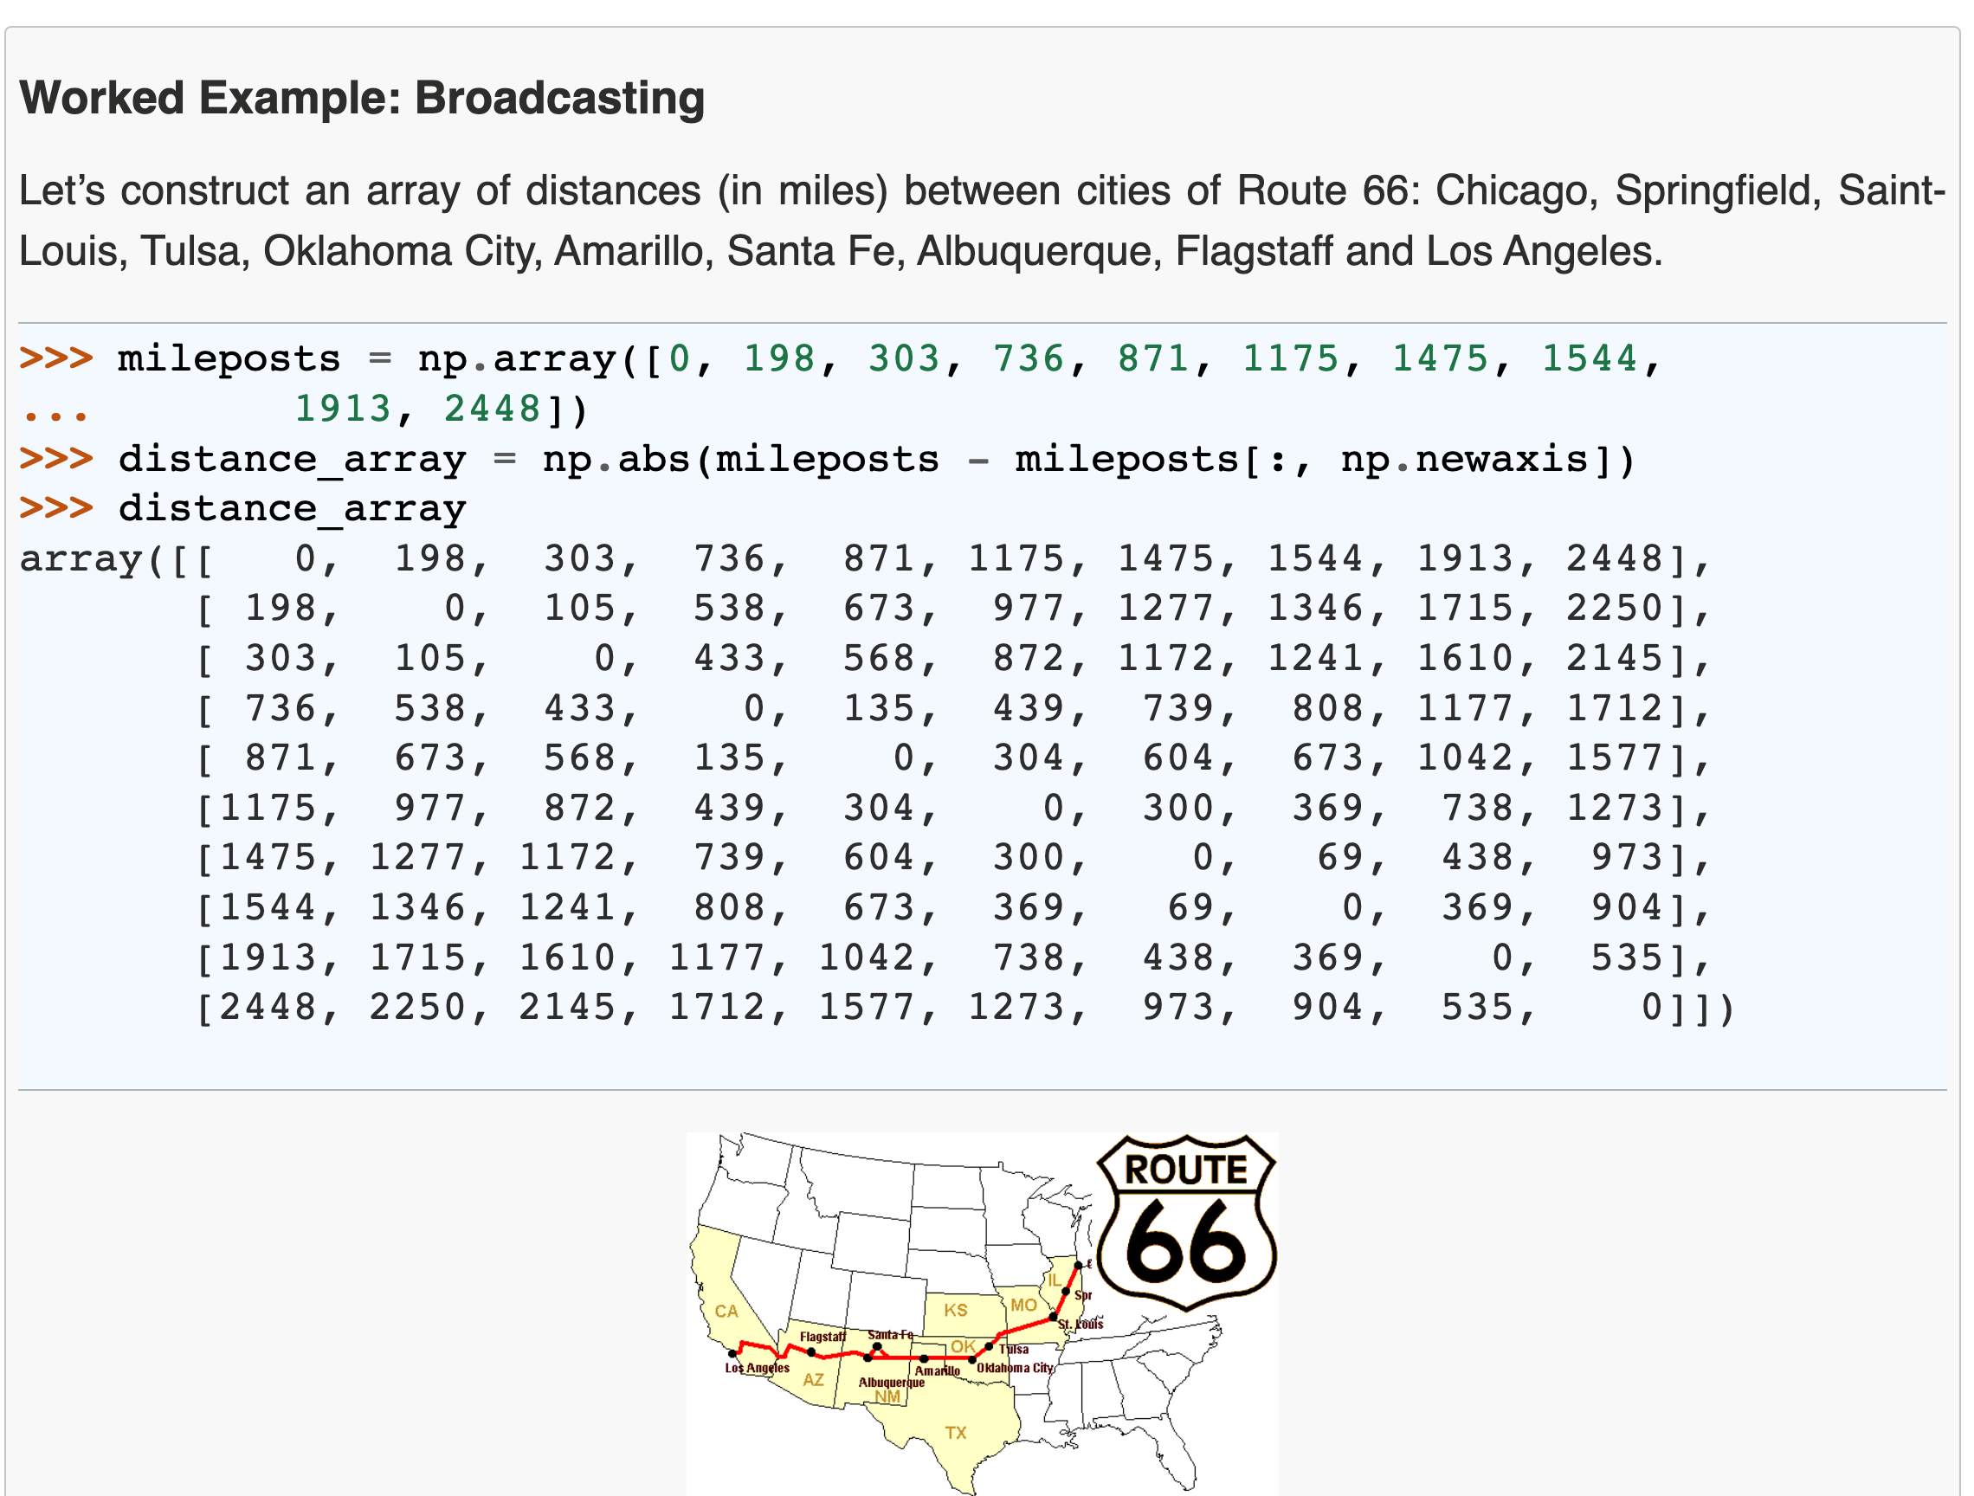
Notes:
Idea for an exercise

Slide 49
NumPy’s speed efficiency

Slide 50
For loops in C
Show how a numpy operation can be executed very fast in C
Related to memory: the data is of a C numerical type, and the layout is regular in memory. A C loop can jump from one memory location to the next by moving by “strides” bytes and accumulating the result
To get that performance, one needs to vectorize! it’s important to avoid for-loops at all costs
Question: How is efficiency of Python vs C in the Big-O sense?
Notes:
`
a = x[::2, 3]
a.sum()
start_memory_pos = a.data
a.dtype sum = 0
for i in a.shape[0]:
for j in a.shape[1]:
memory_pos = start_memory_pos + a.strides[0] * i + a.strides[1] * j
sum += cast_to(memory_pos, a.dtype)

Slide 51
Here list useful NumPy functions that help vectorize for-loop code
VM
Make a reference slide with useful things to vectorize for-loops
broadcasting
mgrid
…
Find a couple of nice examples where complicated for-loop code is nicely vectorized
Notes:
Reference slide for commands that can be used to avoid for loops

Slide 52
Exercise: give python code with for-loops and ask them to vectorize
proposal for exercise: numpy_vectorize

Slide 53
Hands on: Connecting the dots with the computer architecture class
We want to compute the sum of all elements of a sliced array, x[::step_i, ::step_j].sum() Discuss the memory and speed efficiency of this expression
Think about Verjinia and Tiziano’s architecture class
Is there any scenario where creating a copy of the sliced array could improve efficiency? x[::step_i, ::step_j].copy().sum()
see when_copying_is_convenient notebook
Keep this slide only if we can find a realistic case where this is useful, i.e. one where we don’t do
s.sum() for 1000 times
Notes:
Each element in a different memory page → slice every time you need to look at a different memory page
100 different operations on the same slice, it’s better to copy to avoid reading many memory pages
Strides larger than the memory page

Slide 54
Beyond memory (briefly, optional, probably skip)
Use memmap with NumPy (keep large array data on disk)
HFD-5 (keep large array data on disk , block-order, example from geophysics project)
blosc (compressed data) -> maybe do not present, never seen anyone use it

Slide 55
HERE INSERT Tabular Data SLIDES

Slide 56
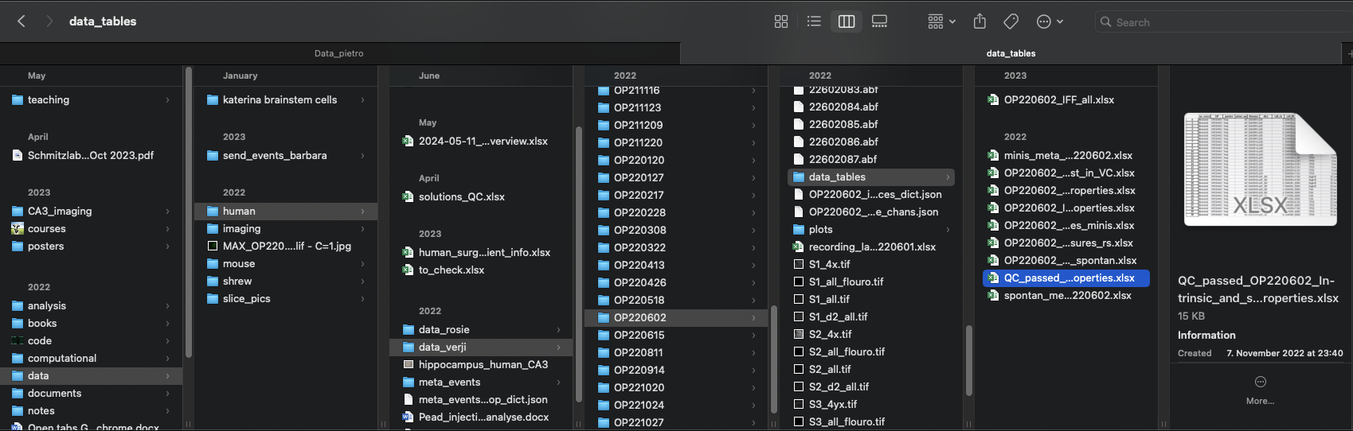

Slide 57
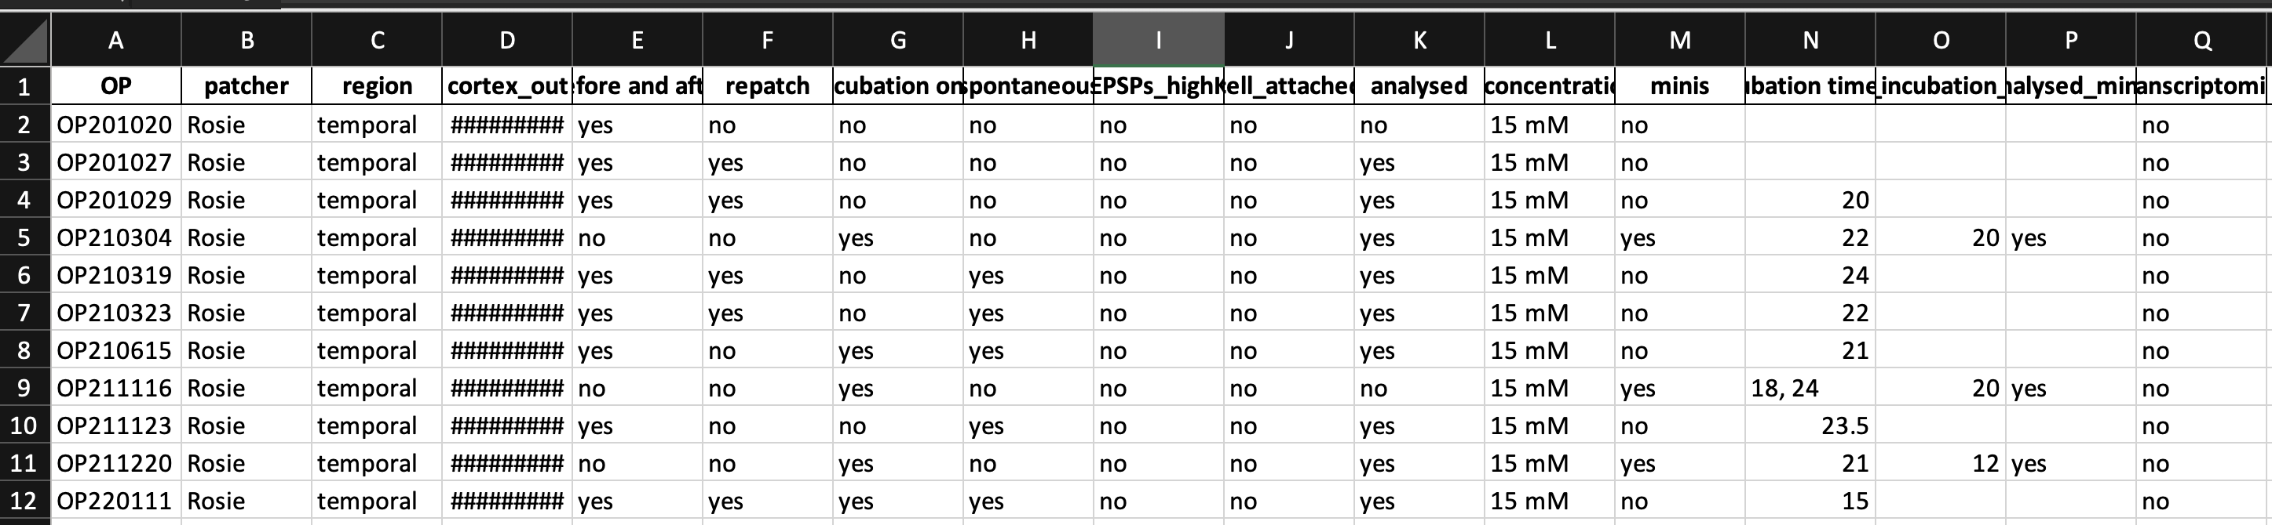
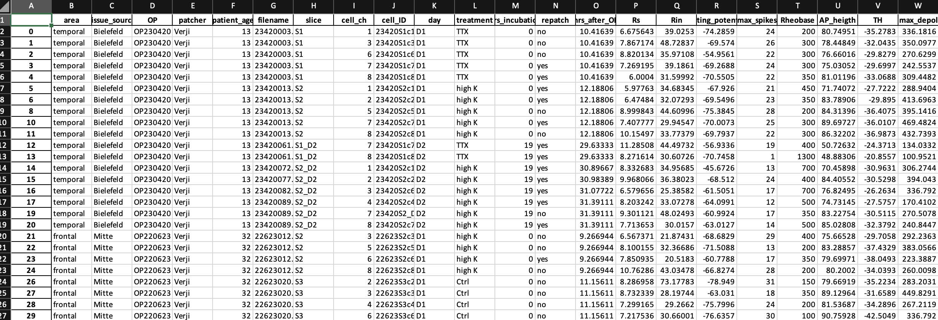
Example data
Metadata: updated when new data is added; one line per experiment
Summary data, after QC, collected from each experiment folder and combined, here 8 measures. Columns P to W
Notes:
Slide with recording and some explanation of the measureents

Slide 58
Thank you!

Slide 60
Data class outline
TO BE REMOVED
Introduction
what data structures do you know? list, dictionary, set, tree, graph, array, database, …
you could store data in a dictionary as a list — what makes you choose a data structure over another? speed (dictionary retrieval O(1), list O(n), demo this) memory (on disk, in memory)
for what kind of data is each of the data structure good? list, dictionary … numpy array -> n-d grid of data of the same basic type; efficient use of memory and for loops implemented at C-level for some operations pandas DataFrame -> records of different types, e.g. info about experiment subscriber, experiment results by subscriber and condition, … ; efficient operations on columns; easy statistics and analytics on groups
homogeneous array data: numpy
only small changes to numpy class to stress the overall topics
one thing I suggest to add: memmap. What does it do, how much in this case it’s important to think about the operations we want to do on the array: view vs copy; random sampling is going to load all of the memory pages the samples are in. Even C- and Fortran-order are going to have a different impact on memory usage
mention that HDF5 can also be used for efficient on-disk storage of array data
heterogeneous, column-based data with index: pandas
the topics of this part apply to pandas, spark, SQL databases, dask, … : they all share the same basic concepts; we’ll use pandas for convenience
“tidy data” ideas
just as in numpy, avoiding for loops is critical for both memory and speed consumption
split, map, aggregate -> basic ideas, related to tidy data; summary tables, pivots
joins and anti-joins: basic and also how they can make some filtering cases easy, without for loops
window functions
coalescing: selecting one of several computations based on priority (eliminates if .. else mapping)
briefly discuss strengths of pandas, spark, SQL databases, dask
(possibly) data organization topics
data processing stages
handling changes in the data
missing values

Slide 61
Goals (will be removed)
TO BE REMOVED
Goals:
Brief introduction to data structures
why are there many? what are the trade-offs? Basic facts about Python lists, sets, and dictionaries (exercise)
arrays, grid of homogeneous data (numpy)
efficient storage in memory, interpretation layer, and C-level loops
knowing this makes it easy to understand: view vs copy; when is C- or F-order better
off-memory array: memmaps, HDF5 (and beyond C- and F-order, example 3D geodata)
blosc: memory-compressed arrays
tables, indexed columns of inhomogeneous data (pandas, dask, sql, …)

Slide 62
TO BE REMOVED
Part 1: data structures
which data structures exist?
which ones do we use most commonly in research? array, tables
why do we have many?
access time, memory, and algorithms (exercise)
Part 2: arrays (numpy)
why is it efficient? separate storage in memory from interpretation; copy vs view; broadcasting
it’s only efficient if you don’t do for loops: the for loops are done in the native C
exercises for that
memory maps -> on-disk arrays
HDF5 -> on-disk, chunked arrays
more: compressed storage (blosc)
Part 3: tables (pandas, dask, SQL, …)
calculations are done by column, rows have index
it’s only efficient if you don’t do for loops: split-group-appy, join, window functions
exercises for that
concept of “tidy data”, show example of difficult operation on table that becomes easy with tidy data

Slide 63
Data types
TO BE REMOVED
obvious but: different data structures are for storing different things
lists: sequences, ordered items -> stack, queue; sorted search
sets: bunch of items, no order
dictionaries: key-value
what’s maybe not obvious is that these data structures are specialized because they have speed or memory advantages
Q: what is the time to retrieve an item from a list? from a dictionary? from a set?
Numpy also is a specialized data structure
Q (exercise): what data structure would you use to represent
a graph? A: either a dictionary or a numpy array (adjacency matrix)
a sound wave?
have a look at Advent of Code to find other examples
Notes:
Bugs are inevitable

Slide 64
All the data structures
list: ordered, heterogeneous storage, stack/queue, fast access by index, slow search
set: unordered
dictionary
arrays: e.g. numpy, HDF5
tables: e.g. pandas, dask, spark, SQL
graph: social network structure
tree: to rapidly search a dataset
heap
stack
queue
priority queue

Slide 65
Data structures
TO BE REMOVED
You might know the native Python data structures (ask which ones): lists, tuples, sets, and dictionaries
There are also other data structures in the standard libraries
There is a whole theory of data structures
For example:
queue
priority queues
I want to give a taste of how to think about data structures:
what is stored
what are the operations that can be done on them
how they are implemented and how efficient that is, is another matter (e.g. representation of graphs in matrices vs dictionaries)
you don’t need to know the implementation, just the efficiency of each operation

Slide 66
Lists
Content: ordered sequence on items, any data type
Operations (subset):
append
insert
“is in”
search sorted
Implementations can be different!
Python list
Linked list
numpy array
Guess the complexity
Note that a numpy array is similar, but “append” is linear

Slide 67
For example:
Accumulating results in a list vs a numpy array
list: 2*n -> O(n)
array: n * (n – 1) / 2 -> O(n^2)

Slide 68
Dictionaries (“hashmap”)
Content: unordered collection of key-value pairs
Operations:
insert
delete
is in
sets are the same but without value

